Slide 1
Java Persistence
Relationships

Slide 2
Relationships
Common relationships supported:
@ManyToOne, @OneToOne, @OneToMany,
@ManyToMany
Unidirectional or bidirectional
Owning side of relationship can specify physical mapping
@JoinColumn
@JoinTable

Slide 3
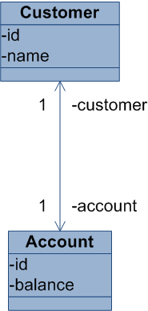
One-to-One
@Entity public class Customer { @Id @GeneratedValue private Long id; private String name; @OneToOne private Account account;
Customer
id
name
account_id
Account
id
balance
@Entity public class Account{ @Id @GeneratedValue private Long id;
private Long balance; @OneToOne(mappedBy = “account") private Customer customer;

Slide 4
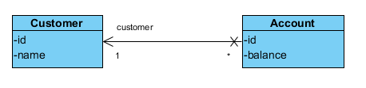
One-to-Many unidirectional 1
@Entity public class Customer { @Id @GeneratedValue private Long id;
private String name;
@Entity public class Account{ @Id @GeneratedValue private Long id;
private Long balance;
@ManyToOne
private Customer customer;
Customer
id
name
Account
id
balance
customer_id

Slide 5
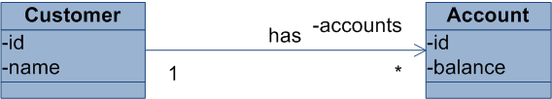
One-to-Many unidirectional 2
@Entity public class Customer { @Id @GeneratedValue private Long id;
private String name; @OneToMany private List<Account> accounts;
@Entity public class Account{ @Id @GeneratedValue private Long id;
private Long balance;
Customer
id
name
Customer_Account
customer_id
account_id
Account
id
balance

Slide 6
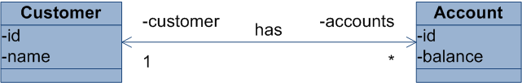
One-to-Many bidirectional
@Entity public class Customer { @Id @GeneratedValue private Long id; @OneToMany(mappedBy = “customer") private List<Account> accounts;
@Entity public class Account{ @Id @GeneratedValue private Long id;
private Long balance;
@ManyToOne
private Customer customer;
passive
Customer
id
name
Account
id
balance
customer_id

Slide 7
Lazy loading
Multi-value associations are by default loaded lazily
prevents loading the whole database...
Collections are proxied and will be loaded when used
An entity must be managed to load associations!
LazyInitializationException

Slide 8
Bidirectional mappings
One side is the “owning” side
The other side is “passive”
the passive side does not synchronize changes
Doesn’t work; relation is not set
works
Customer c = new Customer();
em.persist(c);
Account acc = new Account();
acc.setCustomer(c);
em.persists(acc);
Account acc = new Account();
em.persist(acc);
Customer c = new Customer();
c.getAccounts.add(acc);
em.persists(c);

Slide 9
Fixing the passive side
Common trick to work with passive relations
@OneToMany(mappedBy = “customer") private List<Account> accounts;
public void addAccount(Account acc){
accounts.add(acc);
acc.setCustomer(this);
}
Account acc = new Account();
em.persist(acc);
Customer c = new Customer();
c.addAccount(acc);
em.persists(c);
Set the owning side

Slide 10
Cascading
Customer customer = new Customer();
Account account = new Account();
account.setCustomer(customer);
em.persist(account);
TransientObjectException
The referenced customer is
not persisted yet

Slide 11
Cascading operations
Cascading can be set on all relationship annotations
Default: no cascading
Values: PERSIST, MERGE, REMOVE, REFRESH, ALL
@ManyToOne (cascade = CascadeType.PERSIST)
private Customer customer;
@ManyToOne (cascade =
{CascadeType.PERSIST, CascadeType.MERGE})
private Customer customer;
Decide on entity-by-entity the most appropriate cascading setting

Slide 12
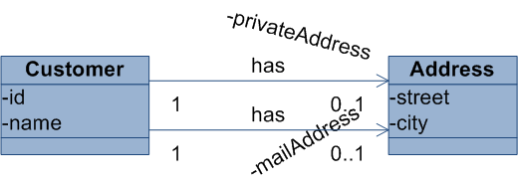
Embeddables
Collections of simple types or embedables
@Entity public class Customer { @Id @GeneratedValue private Long id;
private String name;
@Embedded
@AttributeOverrides({
@AttributeOverride(name = “street",
column = @Column(name = “p_street")),
@AttributeOverride(name = “city",
column = @Column(name = “p_city"))}) private Address privateAddress;
@Embedded
private Address mailAddress;
@Embeddable public class Address { private String street;
private String city;
Customer
id
name
p_street
p_city
street
city

Slide 13
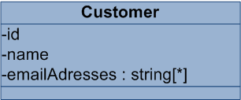
Value collections
Map collection of Basic objects
@Entity public class Customer { @Id @GeneratedValue private Long id;
private String name;
@ElementCollection
private Set<String> emailAddresses;
Customer
id
name
Customer_emailAddresses
customer_id
emailAddresses

